Slide 1

Facebook Ads and Influencer Marketing
Soham Bhattacharya

Slide 2
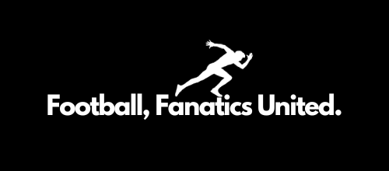
Football, Fanatics United.
“Football, Fanatics United.” abbreviated as FFU, is the brand I've established with the intention of retailing football shoes, commonly referred to studs.

Slide 3
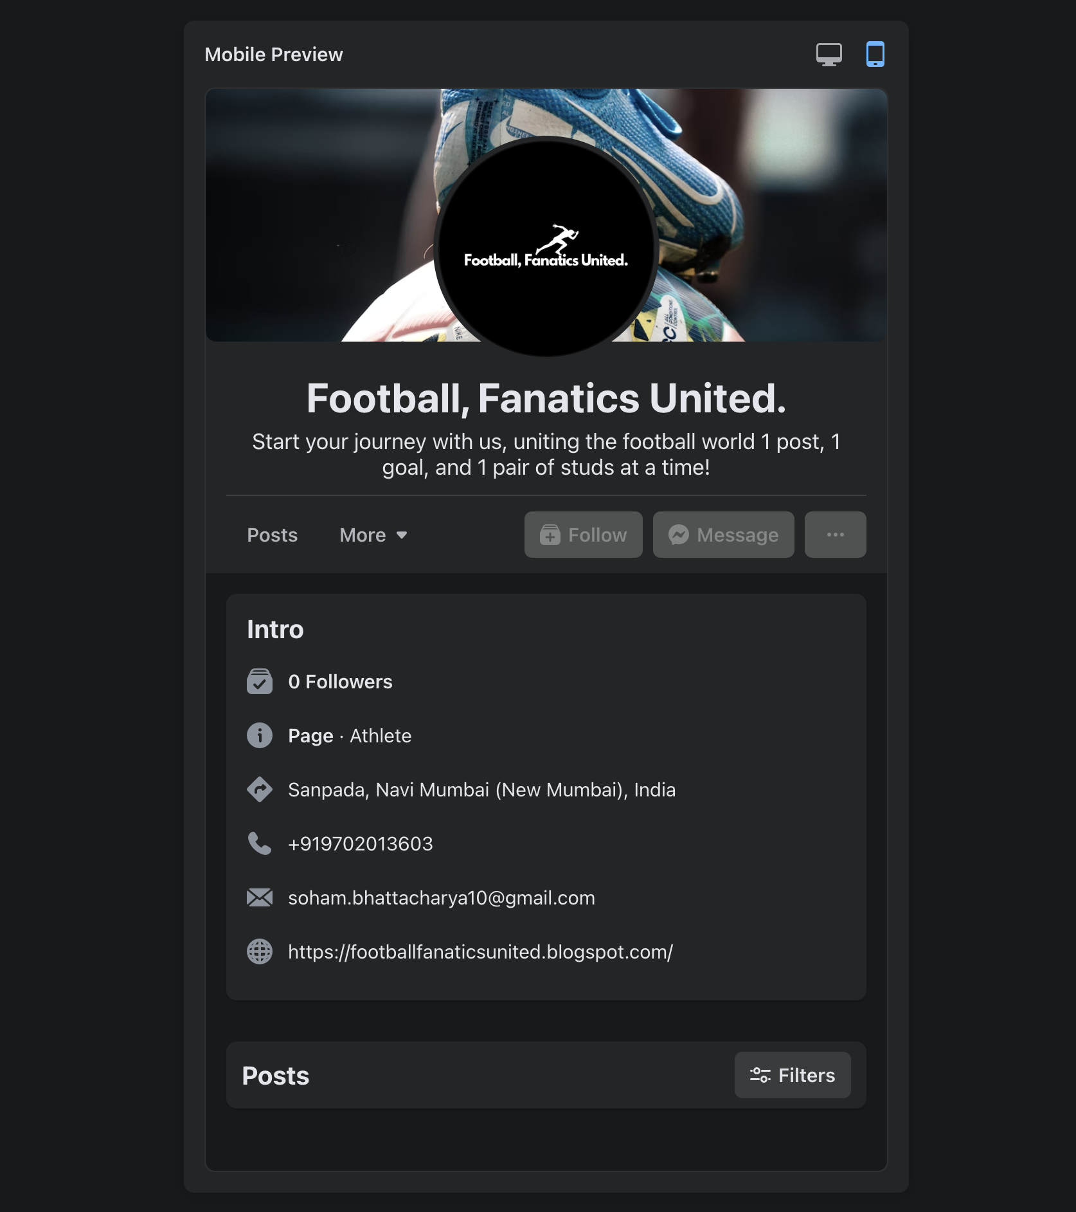
Concept
The concept is to promote the product—football shoes, commonly referred to as studs, specifically Nike football studs.
The specific niche I've targeted for my Influencer Marketing Strategy aligns with my Facebook page, focusing on the fitness category, and more precisely, Footballer Fitness Influencer.
I've chosen the page categories as Athlete, Footwear Store, and Sports. I plan to promote my products through social media by providing valuable, shareable content. This will include creating tips and best practices specifically tailored for footballers.

Slide 4
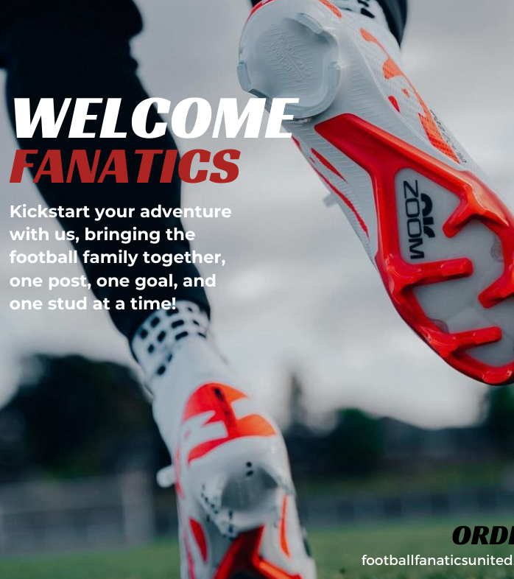
Facebook Page- Posts
I've generated 5-6 posts on the recently established Facebook page. Commencing with a welcoming post, I extended greetings to all newcomers. In the pursuit of community-building, I've already familiarised these potential members with the term "fanatics," aligning it with the identity of my brand.
Link: Football, Fanatics United.

Slide 5
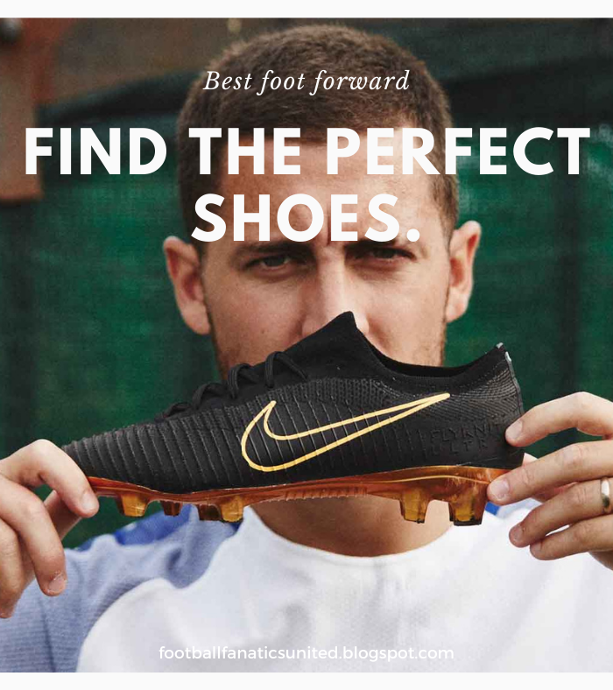
Facebook Page- Posts
In my upcoming post, I'm promoting a blog, and you might wonder why a blog? Well, the marketing approach involves sharing valuable information in return for engagement. The featured blog delves into various types of shoe soles, helping you discover the ideal pair for your feet!
Link to the post: FFU Post 1

Slide 6
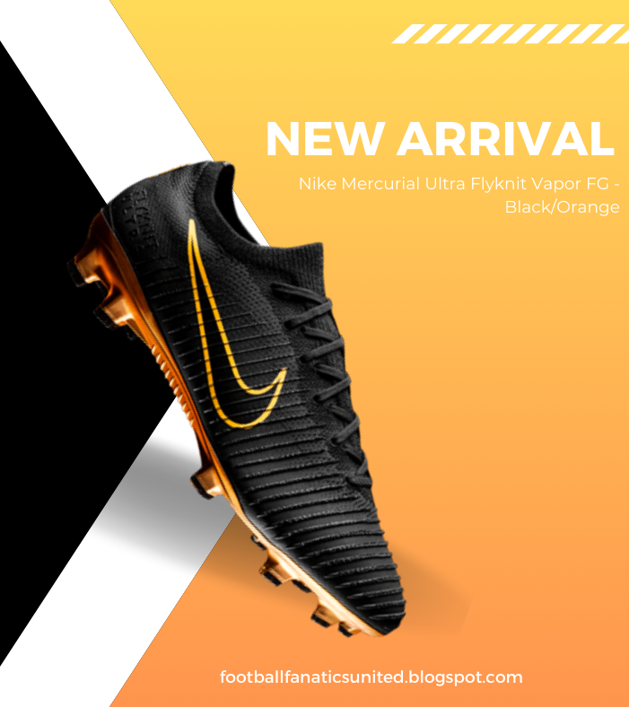
Facebook Page- Posts
Even though my store and website aren't operational yet, I've opted to showcase the products I currently have. The objective is to foster organic growth, making this post a promotion of the available products.
Link to the post: FFU Post 2

Slide 7
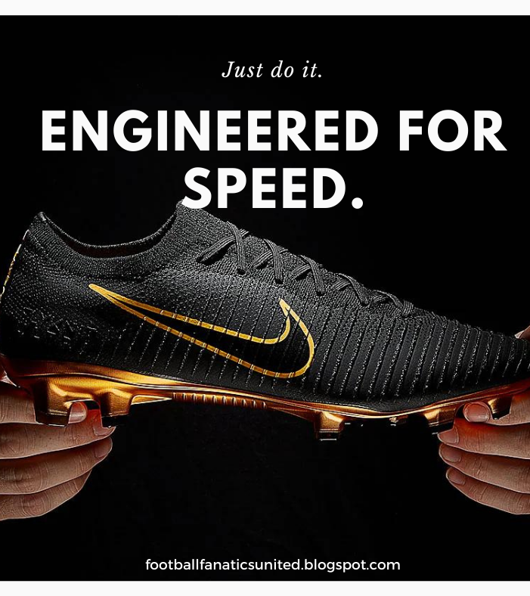
Facebook Page- Posts
Continuing from the previous post, I want to mention that all the posts and images are crafted by me, Soham Bhattacharya, using Canva. This is an example of another product detail post.
Link to the post: FFU Post 3

Slide 8
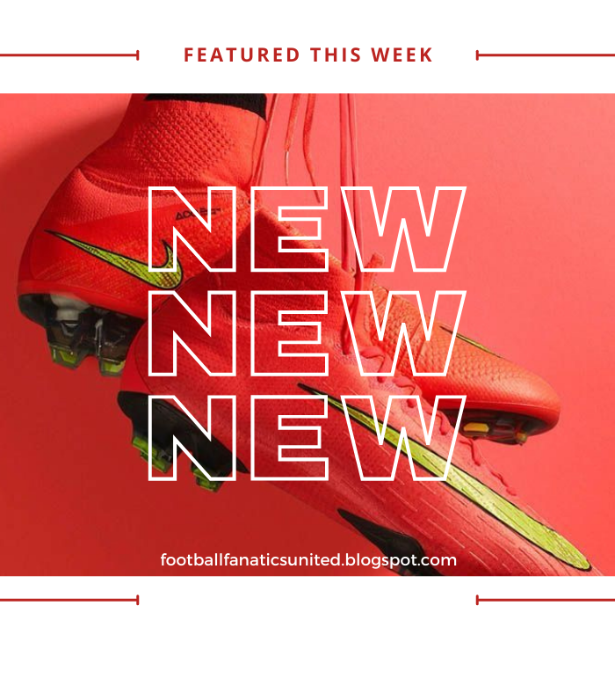
Facebook Page- Posts
Returning to the fundamentals, here's another blog post offering valuable content in exchange for engagement. This time, the blog explores creative ways to tie your shoelaces, tailored to different activities. For example, the lacing technique for a footballer differs from that of someone hiking or playing basketball.
Link to the post: FFU Post 4

Slide 9
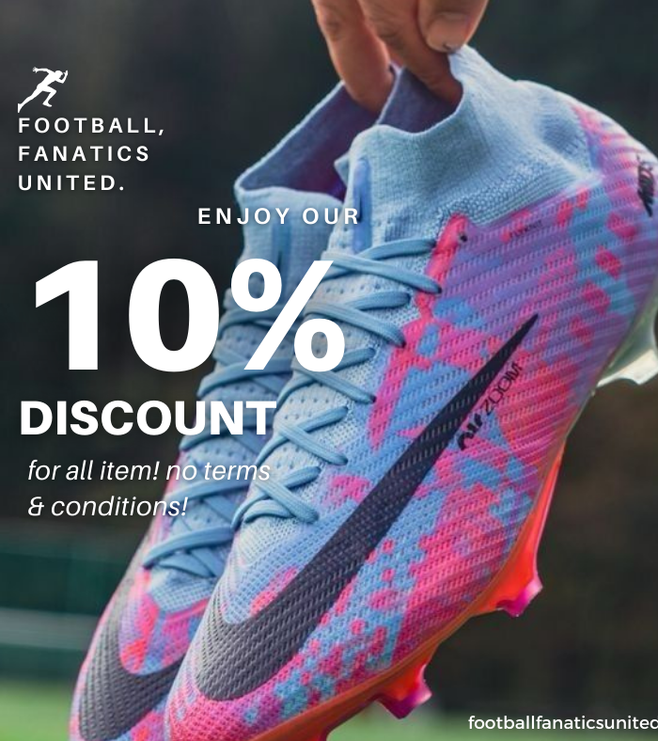
Facebook Page- Posts
While there isn't a discount, product, or store to highlight, I've curated this post to engage with customers. It can be used as a tool to influence consideration. I’ve implemented various hashtags throughout each post within the niche.
Link to the post: FFU Post 5

Slide 10
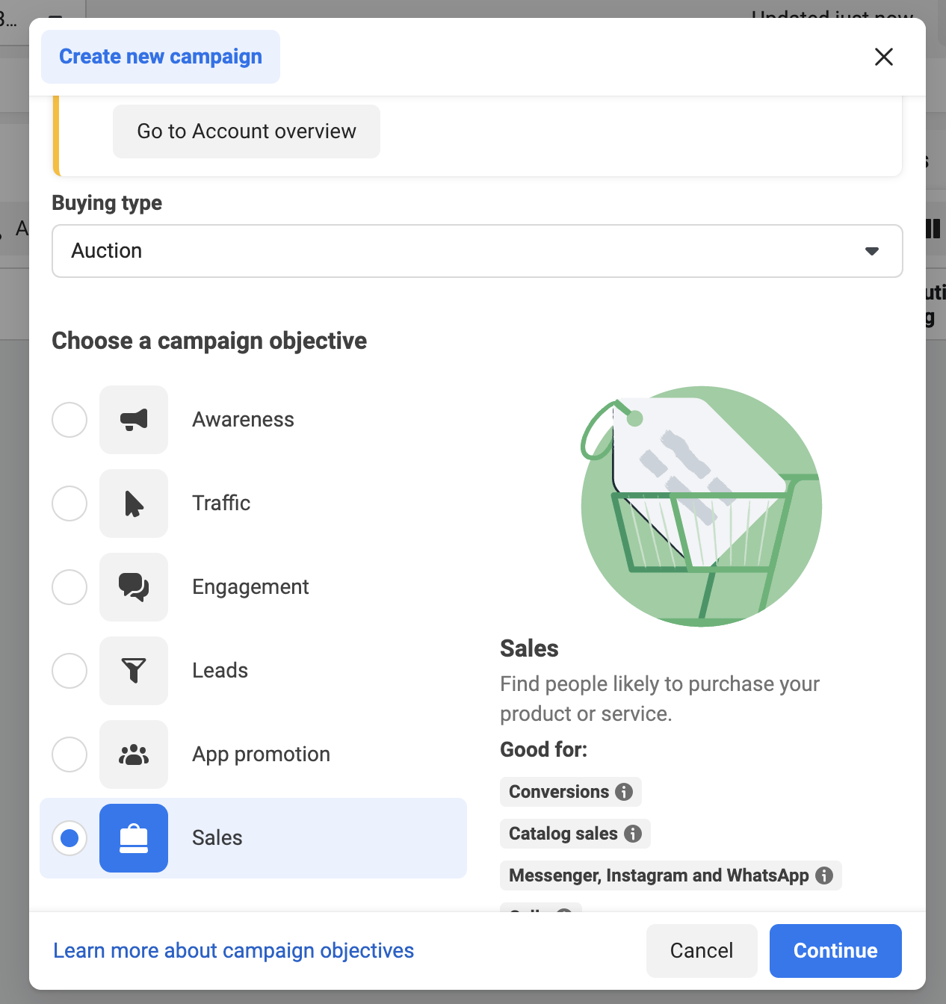
Facebook Ads- Campaign
At the campaign level, our focus in the Facebook ads is solely on drive action. To align with this objective, we've chosen 'Sales' as the campaign objective. It's worth noting that, at present, we don't have an active website. Therefore, we've input a hypothetical URL to accommodate the current campaign setup.
And buying type as the general Auction Buying.

Slide 11
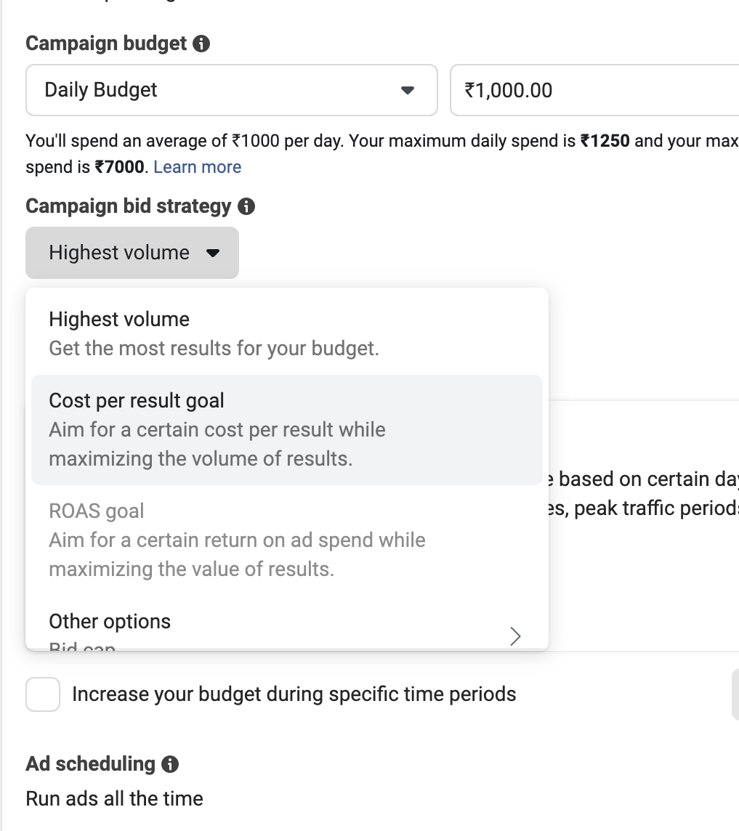
Facebook Ads- Budget & Bids
In terms of budget allocation, we've established a Daily Budget of ₹1,000 for the campaign. To maximise outcomes within this budget framework, we've opted for the 'Highest Volume' bidding strategy, allowing Facebook to attain the greatest results efficiently.
Additionally, concerning ad scheduling, Run ads all the time gets default after selecting daily budget.

Slide 12
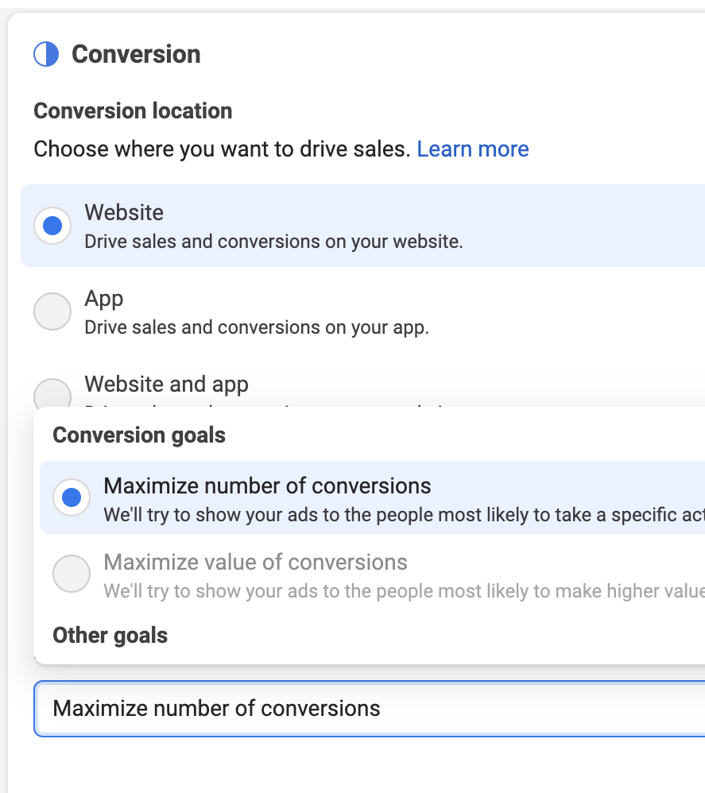
Facebook Ads- Conversion
In our strategic approach, we've chosen the website as the destination for all conversions, aligning seamlessly with our overarching goal of organic page growth. By utilising ads to prompt specific actions, we've selected the 'Maximise the number of conversions' option. This means Facebook will strategically display ads to individuals who are most likely to take the desired actions, optimsing the effectiveness of our campaign.

Slide 13
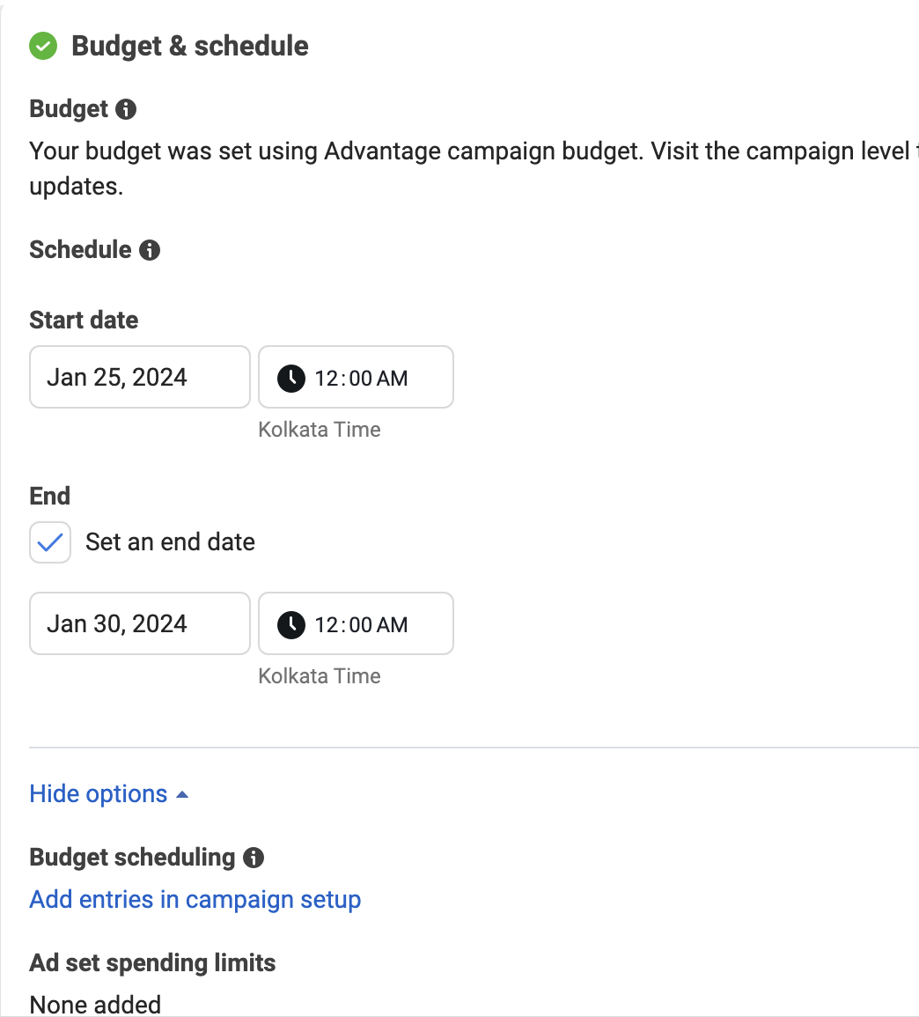
Facebook Ads- Budget & Schedule
Setting the ad schedule to run from Jan 25th, 2024 to Jan 30th, 2024.

Slide 14
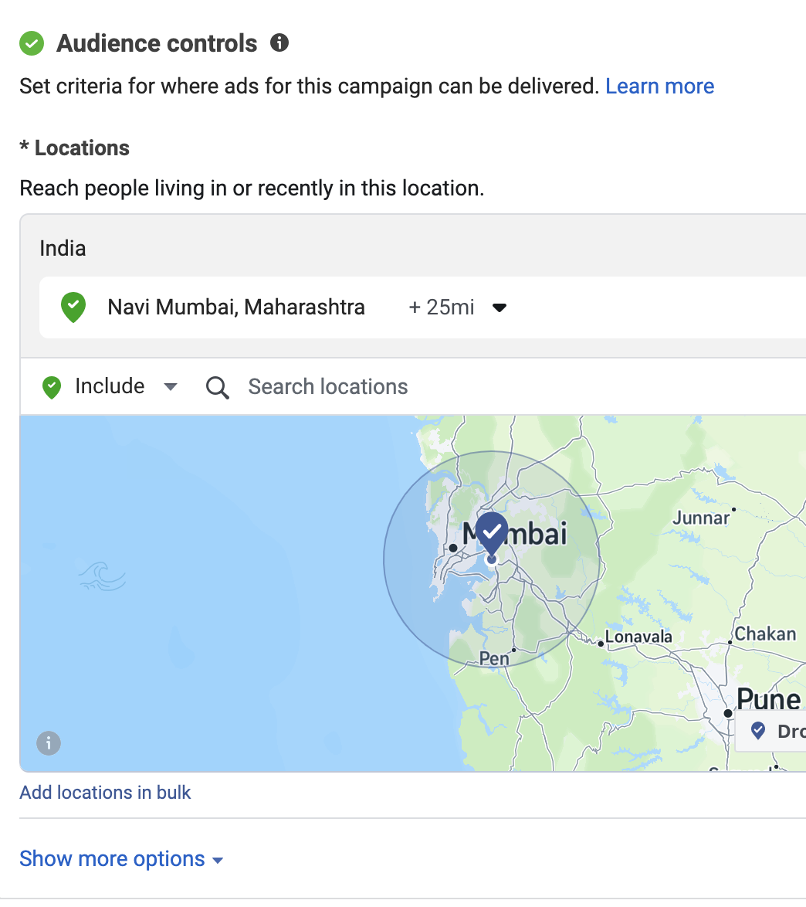
Facebook Ads- Targeting
As part of our influencer marketing strategy, we've tailored our approach to focus on local targeting. To achieve this, our target audience is specifically set at the city level, ensuring that the ads exclusively reach individuals within Navi Mumbai. This precision allows us to effectively engage with the local audience in our future influencer marketing efforts.

Slide 15
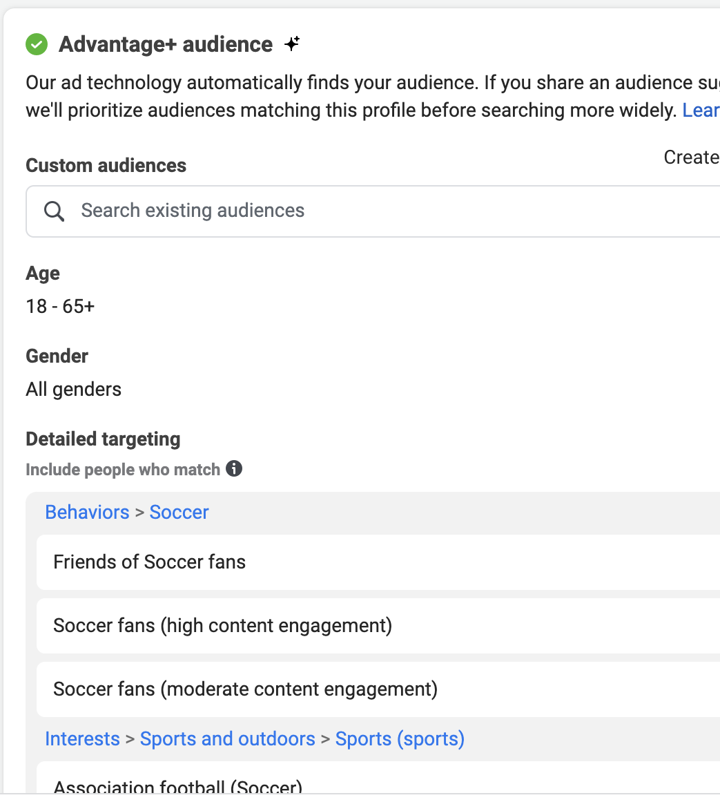
Facebook Ads- Targeting
In the demographic strategy, we've adopted an inclusive approach by setting a broad age range, 18-65+. Given that these football boots cater to a diverse audience, spanning from kids to adults and encompassing both males and females, hence chosen 'All genders' to ensure inclusivity. In terms of detailed targeting, we've honed in on specific interests that correlate with the product and our niche in football/soccer, aiming to resonate with our target audience.

Slide 16
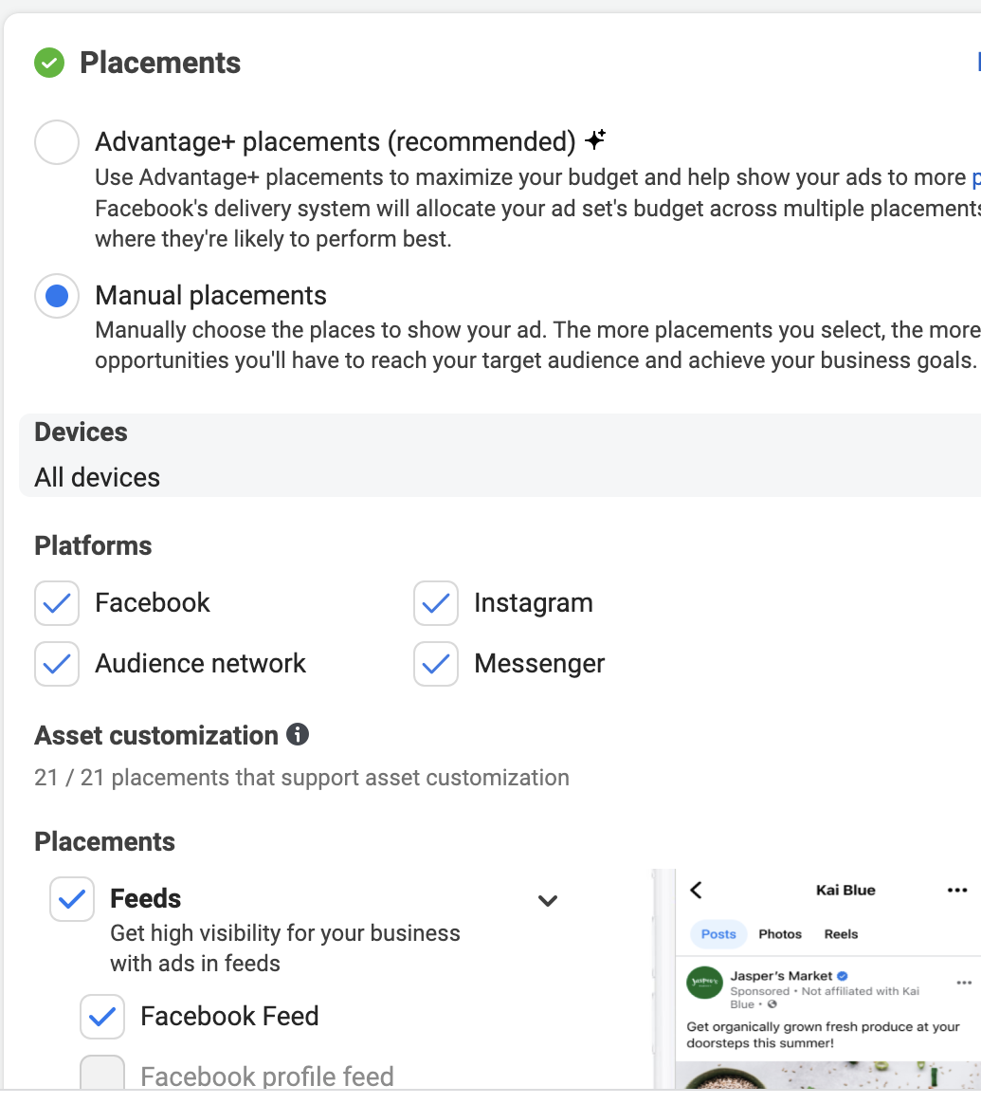
Facebook Ads- Placements
In terms of device categorisation, we've opted for 'All devices,' ensuring that our campaign is visible across various platforms. For ad placements, our approach is hands-on with manual placements, where we've meticulously selected specific ad placements to enhance our control and targeting precision.

Slide 17
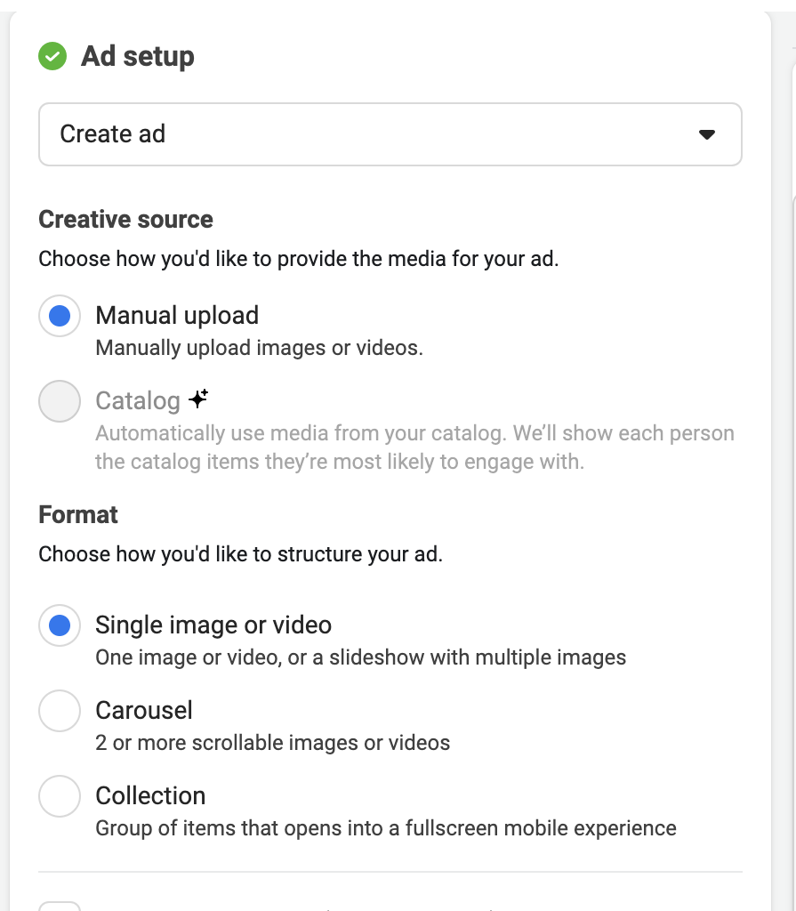
Facebook Ads- Ad Format
In our advertising strategy, we've chosen Create ad rather than utilising a post as an ad. Despite this, we've maintained consistency by selecting a similar image for the advertisement. For the creative source, we opted for Manual upload, manually providing the images for the ad. Considering we're promoting a single product, we've chosen the format of a Single image or video. If we had a catalog of products, carousel or collection formats would have been more suitable for a comprehensive display

Slide 18
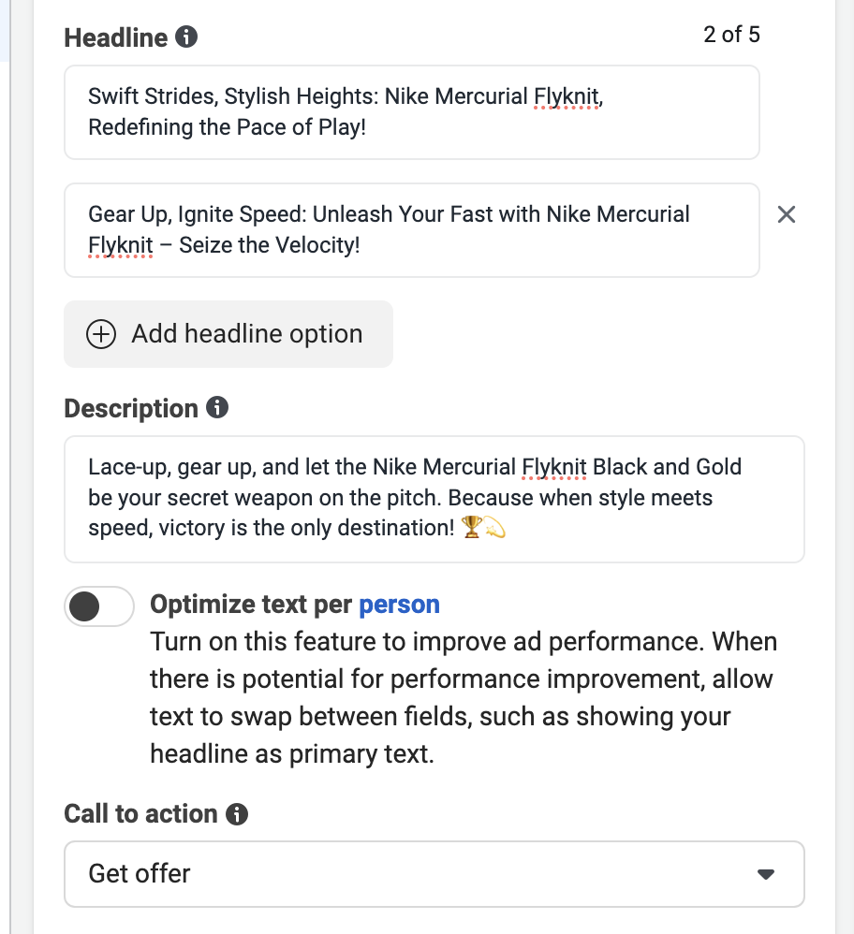
Facebook Ads- Creatives
In crafting our ad, we've incorporated multiple headlines, primary text, and descriptions to enhance engagement and capture attention. For the call-to-action button, we strategically chose 'Get Offer' to evoke curiosity and create a personalised touch, enticing users with the anticipation of a revealed price.

Slide 19

Facebook Ads and Influencer Marketing
Soham Bhattacharya

Slide 20
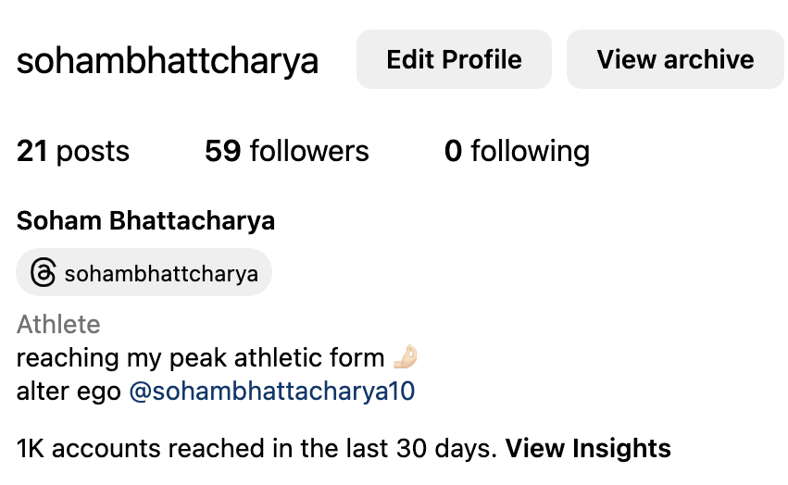
Niche
The initial phase involves niche selection, and I've pinpointed fitness, delving even further into footballer fitness. This particular niche revolves around the training and workouts specific to footballers.
Following this, we proceed by creating an Instagram Creator Account, categorising it under the profile category 'Athlete' to align with the chosen fitness niche.

Slide 21
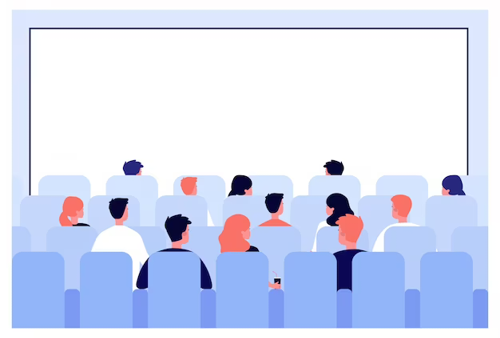
Target Audience
Before embarking on our content plan, it's crucial to establish a clear understanding of our target audience. With our niche in footballer fitness, our primary focus centers on individuals who participate in football for either fitness or entertainment reasons. This encompasses both children and adults actively engaged in football academies or clubs, as well as those with a general interest in watching football. It's noteworthy, however, that the latter group may pose a challenge in terms of targeting, as their interest may be more casual, making conversion potentially more elusive.

Slide 22
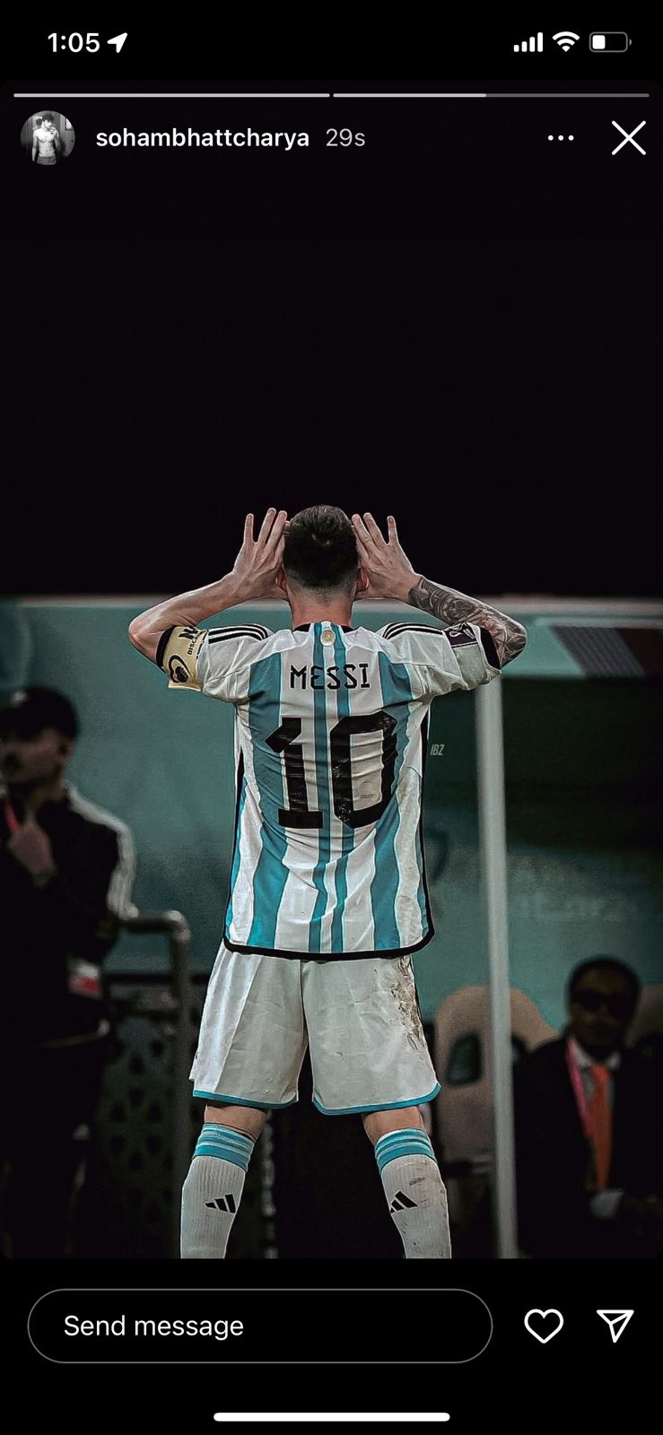
Content Plan
As I aim to reach a diverse audience within the chosen niche, which offers a spectrum of content possibilities, the strategy involves delivering high-quality content through various mediums such as stories, photos, and reels.
For instance, I plan to dedicate a specific day each week to share compelling footballer player/club wallpapers, allowing followers to screenshot and save these visual delights.
In addition, our content calendar includes photo or video posts, where we illustrate various football drills. Given our audience's involvement in football activities, these posts will feature video or photo slides showcasing a variety of beneficial drills for athletes

Slide 23
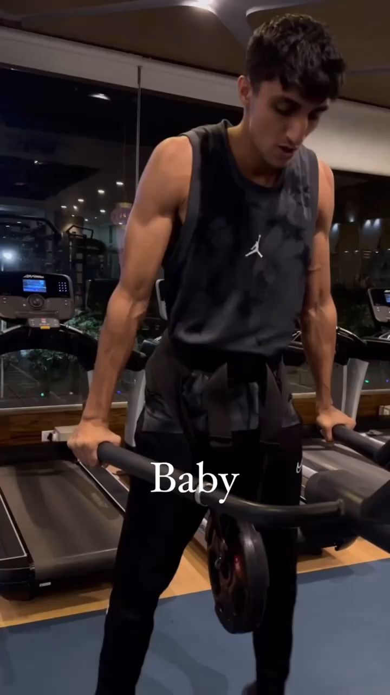
Content Plan
Additionally, leveraging trending audios, and incorporating relevant hashtags, and actively engage in popular Instagram trends, seamlessly integrating the football niche into the ongoing trends and making reels.
Subsequently, the strategy involves providing video reviews on various types of football shoes, detailing their impact on my football game and offering valuable insights to the audience.
In the final stage, our approach includes sharing insightful blog articles on football-related topics, such as football shoes, players, or clubs, on a designated day of the week, enriching our content calendar with valuable and engaging written content.

